Slide 1

SPECIATION

Slide 2
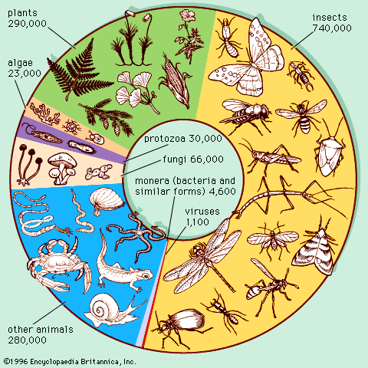
Estimated numbers of species

Slide 3
Speciation
Speciation means the formation of a new species (macroevolution)
A species is defined as a group of organisms that normally interbreed in nature and share the same gene pool
Allopatric species – closely related, live in different areas
Sympatric species – closely related, live in same area


Slide 4
How do new species form?
Some sort of barrier must prevent different populations of an existing species from interbreeding
These barriers can be:
  Prezygotic = before an egg is fertilised
  Postzygotic = after fertilisation


Slide 5
Isolating mechanisms
Ways that populations may be prevented from interbreeding
Geographical barriers
  Oceans, lakes, rivers, deserts, mountain ranges, glaciers
Ecological barriers
  Living in different habitats
Reproductive barriers
  Ways sympatric species are prevented from successfully reproducing


Slide 6











Reproductive Barriers
Pre-zygotic = act before formation of gametes
Post-zygotic = after zygote formation


Slide 7
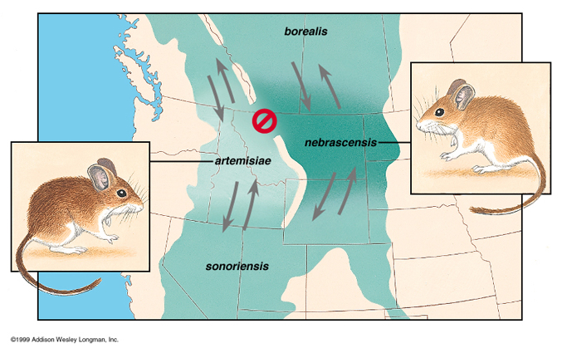
Geographical Isolation
Deer mice species separated by Grand Canyon

Slide 8
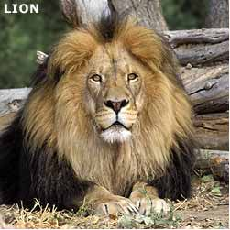
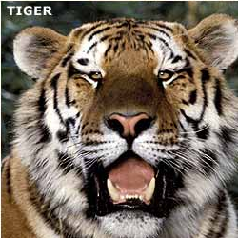
Lions & Tigers Habitat isolation
Tiger habitat is forest from Siberia to Indonesia
Habitat for the lion consists of semi-arid plains and grasslands. Africa and Asia

Slide 9
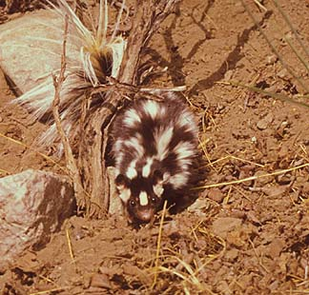
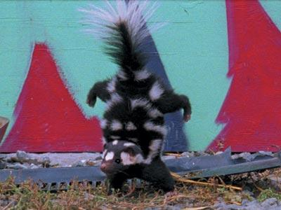
Temporal isolation
Western spotted & Eastern Spotted Skunks.
Range overlaps in the USA but the western skunk breeds in autumn and the eastern in late winter.


Slide 10
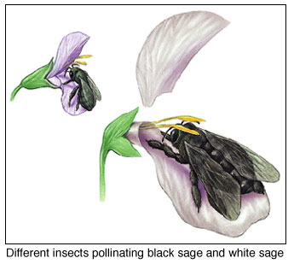
Mechanical isolation
Many flowers are shaped so that they will be pollinated by only one bird or insect species.

Slide 11
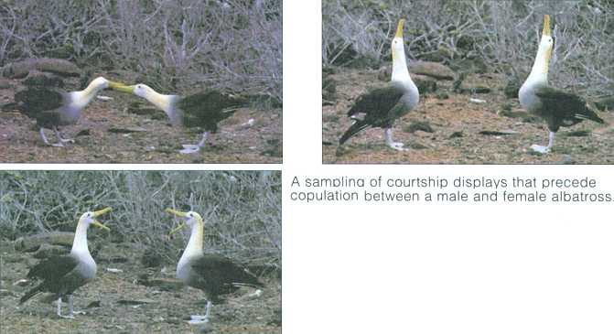
Behavioural isolation
Albatross!!

Slide 12
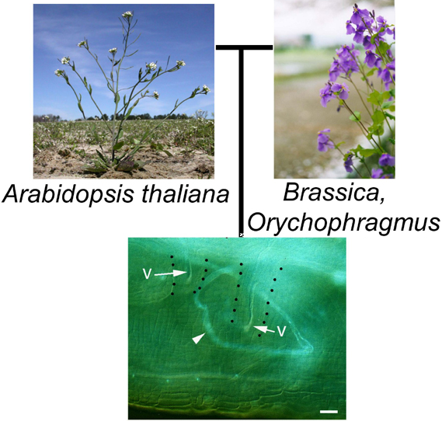
Gametic Isolation
Researchers showed that pollen from one species won’t grow down the stigma of a related species.


Slide 13
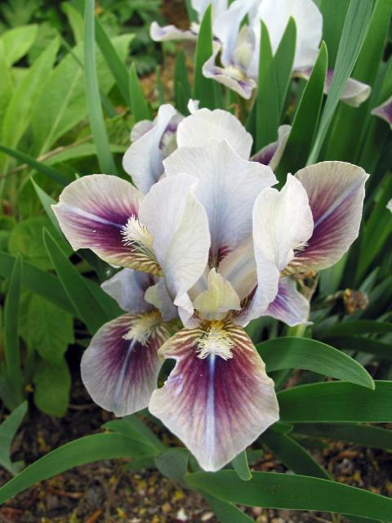
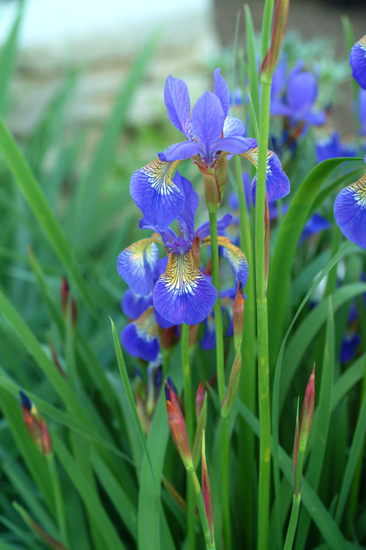
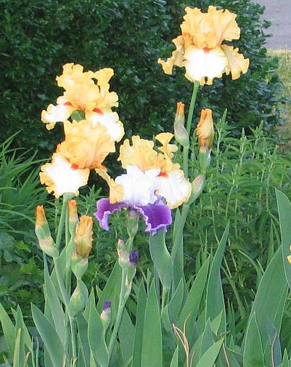
Hybrid inviability,
A zygote forms but does not develop properly.
. In crosses between different species of irises, for example, the embryos die before seeds form.

Slide 14
Hybrid sterility
A hybrid forms but is sterile
E.g. Horse X donkey


Slide 15
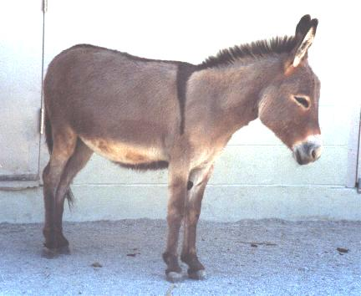
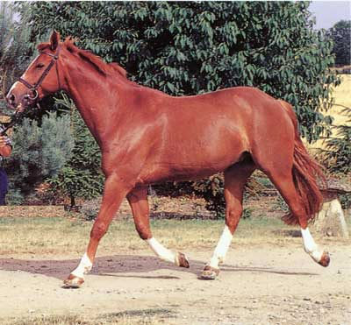
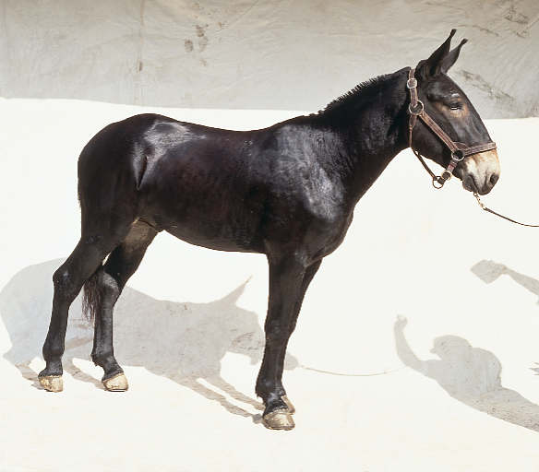
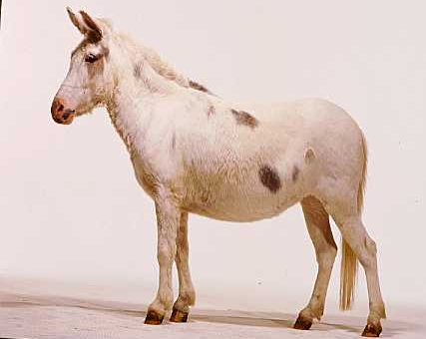
X
Donkey
Horse
♀ Horse X ♂ Donkey
♂ Horse X ♀ Donkey
Mule
Hinny

Slide 16
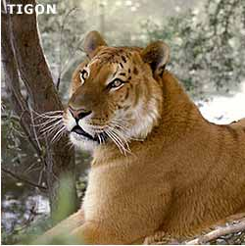
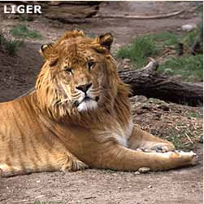
Tigons and Ligers
Tiglon (also called Tion or Tigon): The hybrid offspring of a male tiger and a female lion.
Liger: The product of crossbreeding between a male lion and a female tiger, having features of both but generally being larger than either.
Lions and tigers don’t breed naturally in the wild
All these hybrids are sterile


Slide 17
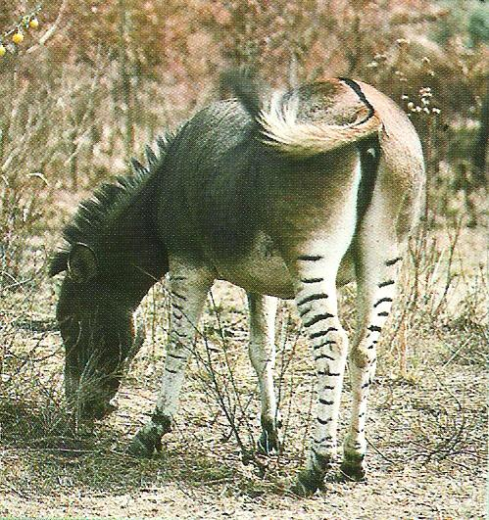
Then there’s the Zebronkey

Slide 18

hybrid breakdown.
If a mating between two F1 hybrids produces a second hybrid generation, this F2 generation may be unable to reproduce because of hybrid breakdown. The second-generation hybrids are defective in some way that prevents successful reproduction. Hybrid breakdown has been demonstrated in sunflower hybrids.

Slide 19
Allopatric speciation
When populations of the same species become separated by a geographical barrier
Allopatric species are species with a common ancestor that are separated by some geographical barrier


Slide 20

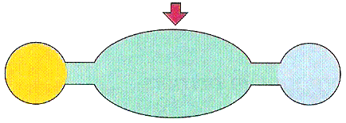
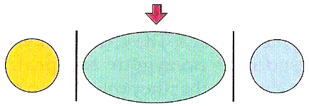
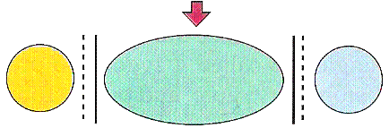
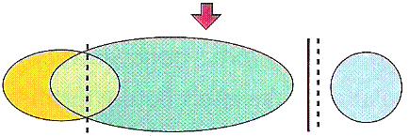
A single species population occupies a uniform environment
Migration into different environments gives rise to racial differentiation
Geographic barriers lead to the geographic isolation of subspecies
Genetic and chromosomal dfferences develop. Interbreeding is no longer possible between groups
Changes may remove the geographic barrier but the reproductive barrier prevents interbreeding 

Slide 21
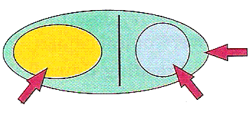
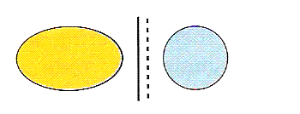
Original species range
Sub-species 1
Sub-species 2
The original range of a species may shrink, thus isolating one subspecies from another by the development of geographic and reproductive bariers


Slide 22
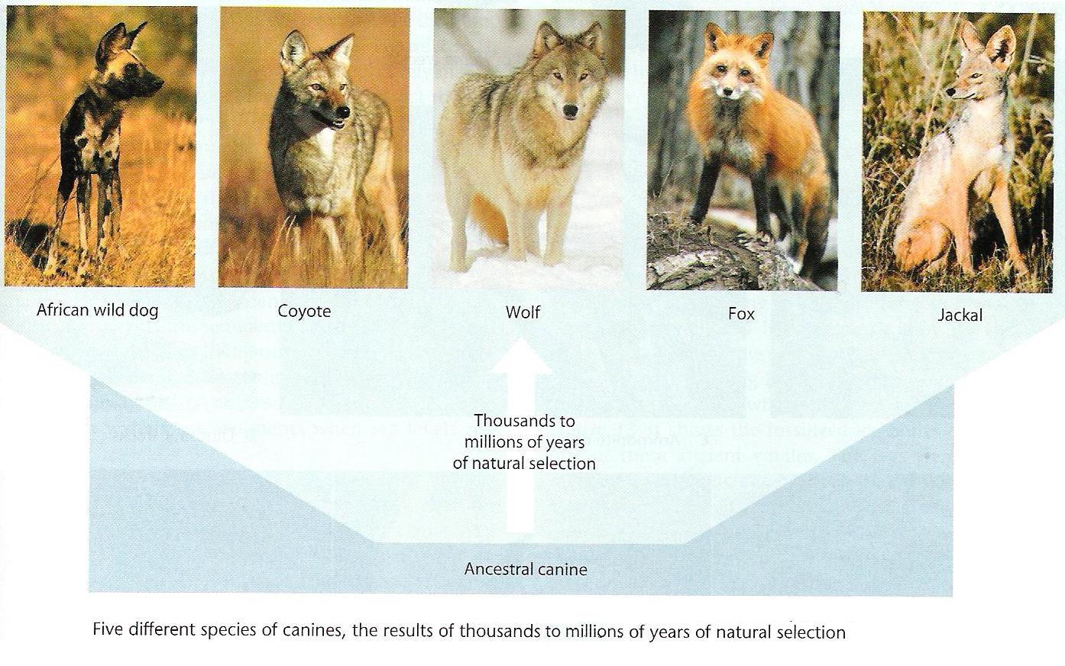
Canines

Slide 23
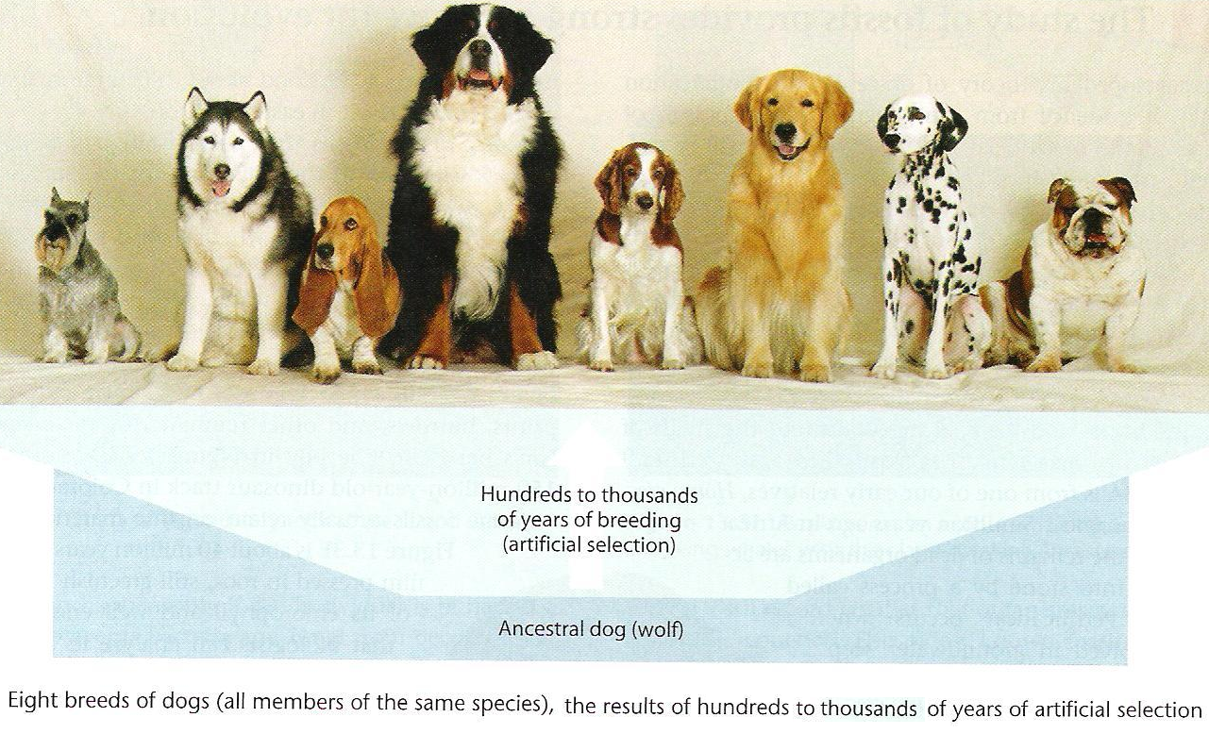
Gone to the dogs

Slide 24
Sympatric speciation
A sub-population becomes reproductively isolated in the midst of its parent population
E.g. when a polyploid plant occurs it may reproduce asexually and form a new species in the midst of its parent species. (=instant speciation)
Sympatric species are those species with a common ancestor whose ranges overlap – but they may have evolved by allopatric speciation


Slide 25
Example of sympatric speciation
200 years ago, the ancestors of apple maggot flies laid their eggs only on hawthorns—but today, these flies lay eggs on hawthorns (which are native to America) and domestic apples (which were introduced to America by immigrants and bred).
Females generally choose to lay their eggs on the type of fruit they grew up in, and males tend to look for mates on the type of fruit they grew up in. So hawthorn flies generally end up mating with other hawthorn flies and apple flies generally end up mating with other apple flies.
This means that gene flow between parts of the population that mate on different types of fruit is reduced. This host shift from hawthorns to apples may be the first step toward sympatric speciation—in fewer than 200 years, some genetic differences between these two groups of flies have evolved. 

Slide 26
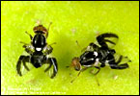
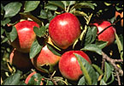
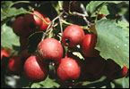
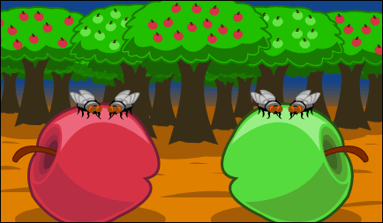
Apple maggot flies apples hawthorns

